Slide 1

Library System
Group#2
Hein Htet Zaw
Joram G Ariho
Hasan Alyousef

Slide 2
Requirements
The Objective of the system is to create a library management system that a librarian can use to checkout books for library members, on the other hand, an administrator can use to add new books to the collection, create new library members, and edit library member information.
In order to access the system, a librarian or administrator must log in where Administrator and Librarians will have different roles.
All members are stored along with their basic information to track their checkout books. Books may be borrowed for 21 or 7 days.

Slide 3
The library can has a book with at least one copy, or multiple copies. Every copy of a book has its own unique copy number.
The checkout record for a library member is a complete record of every book that the member has ever checked out. Each entry records each item checked out, the date of checkout, and the due date.

Slide 4
PROJECT EXECUTION STEPS
1
2
3
4
5
6
Analysis
Analysis
Analysis
Analysis
Design
Implementation
User Requirements
Create
a Static Model
Add
Relationships
to the
Static Model
Create a
Dynamic Model
Enhance the Static and Dynamic Models
Transform
UML into
Code

Slide 5
Use Cases Diagram

Slide 6
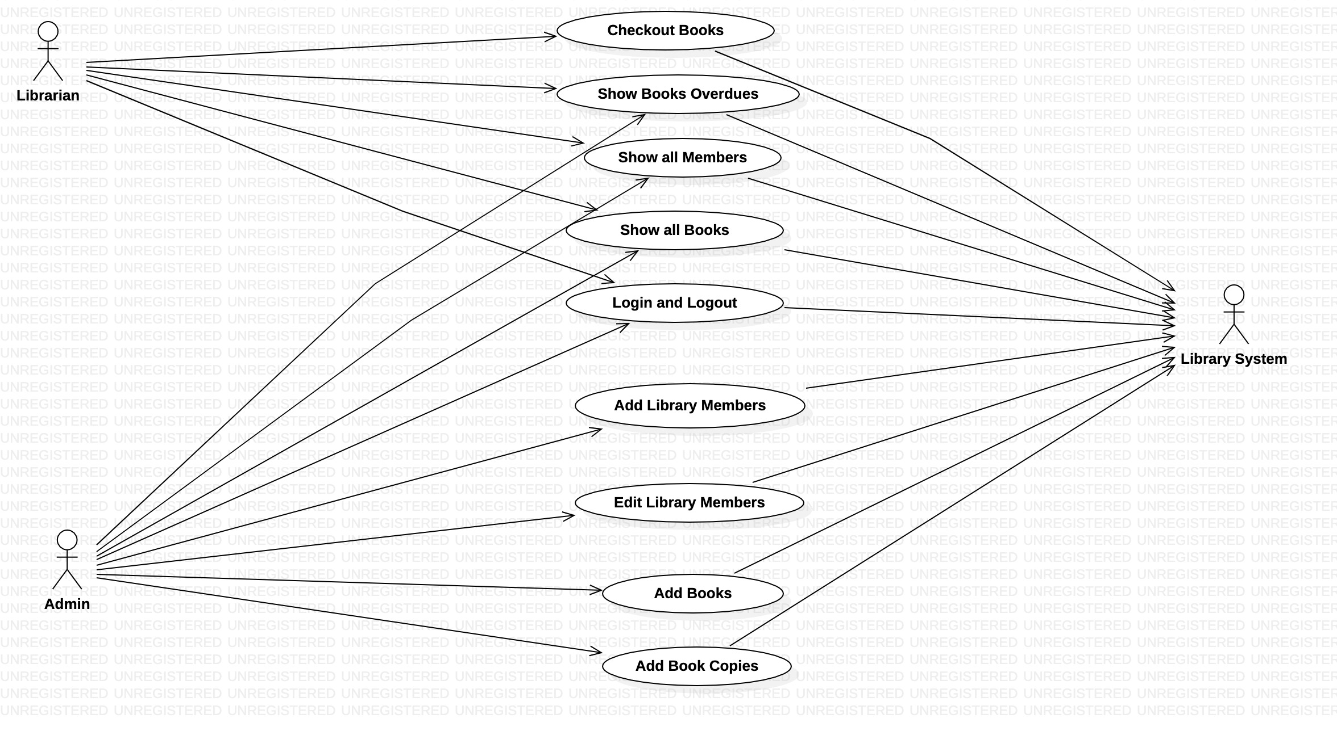

Slide 7
Class Diagram

Slide 8
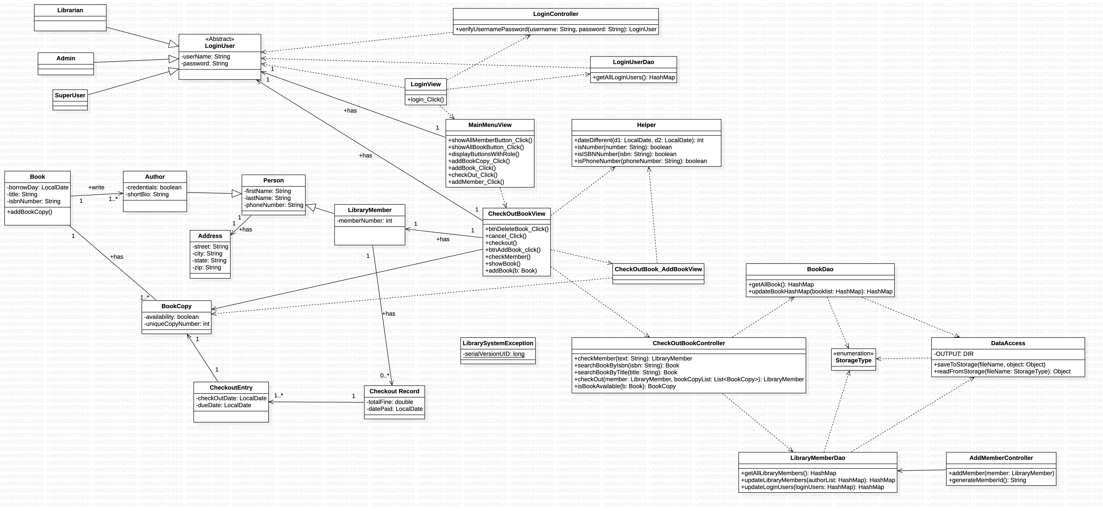

Slide 9
Sequence Diagrams

Slide 10
Add Book Sequence Diagram

Slide 11
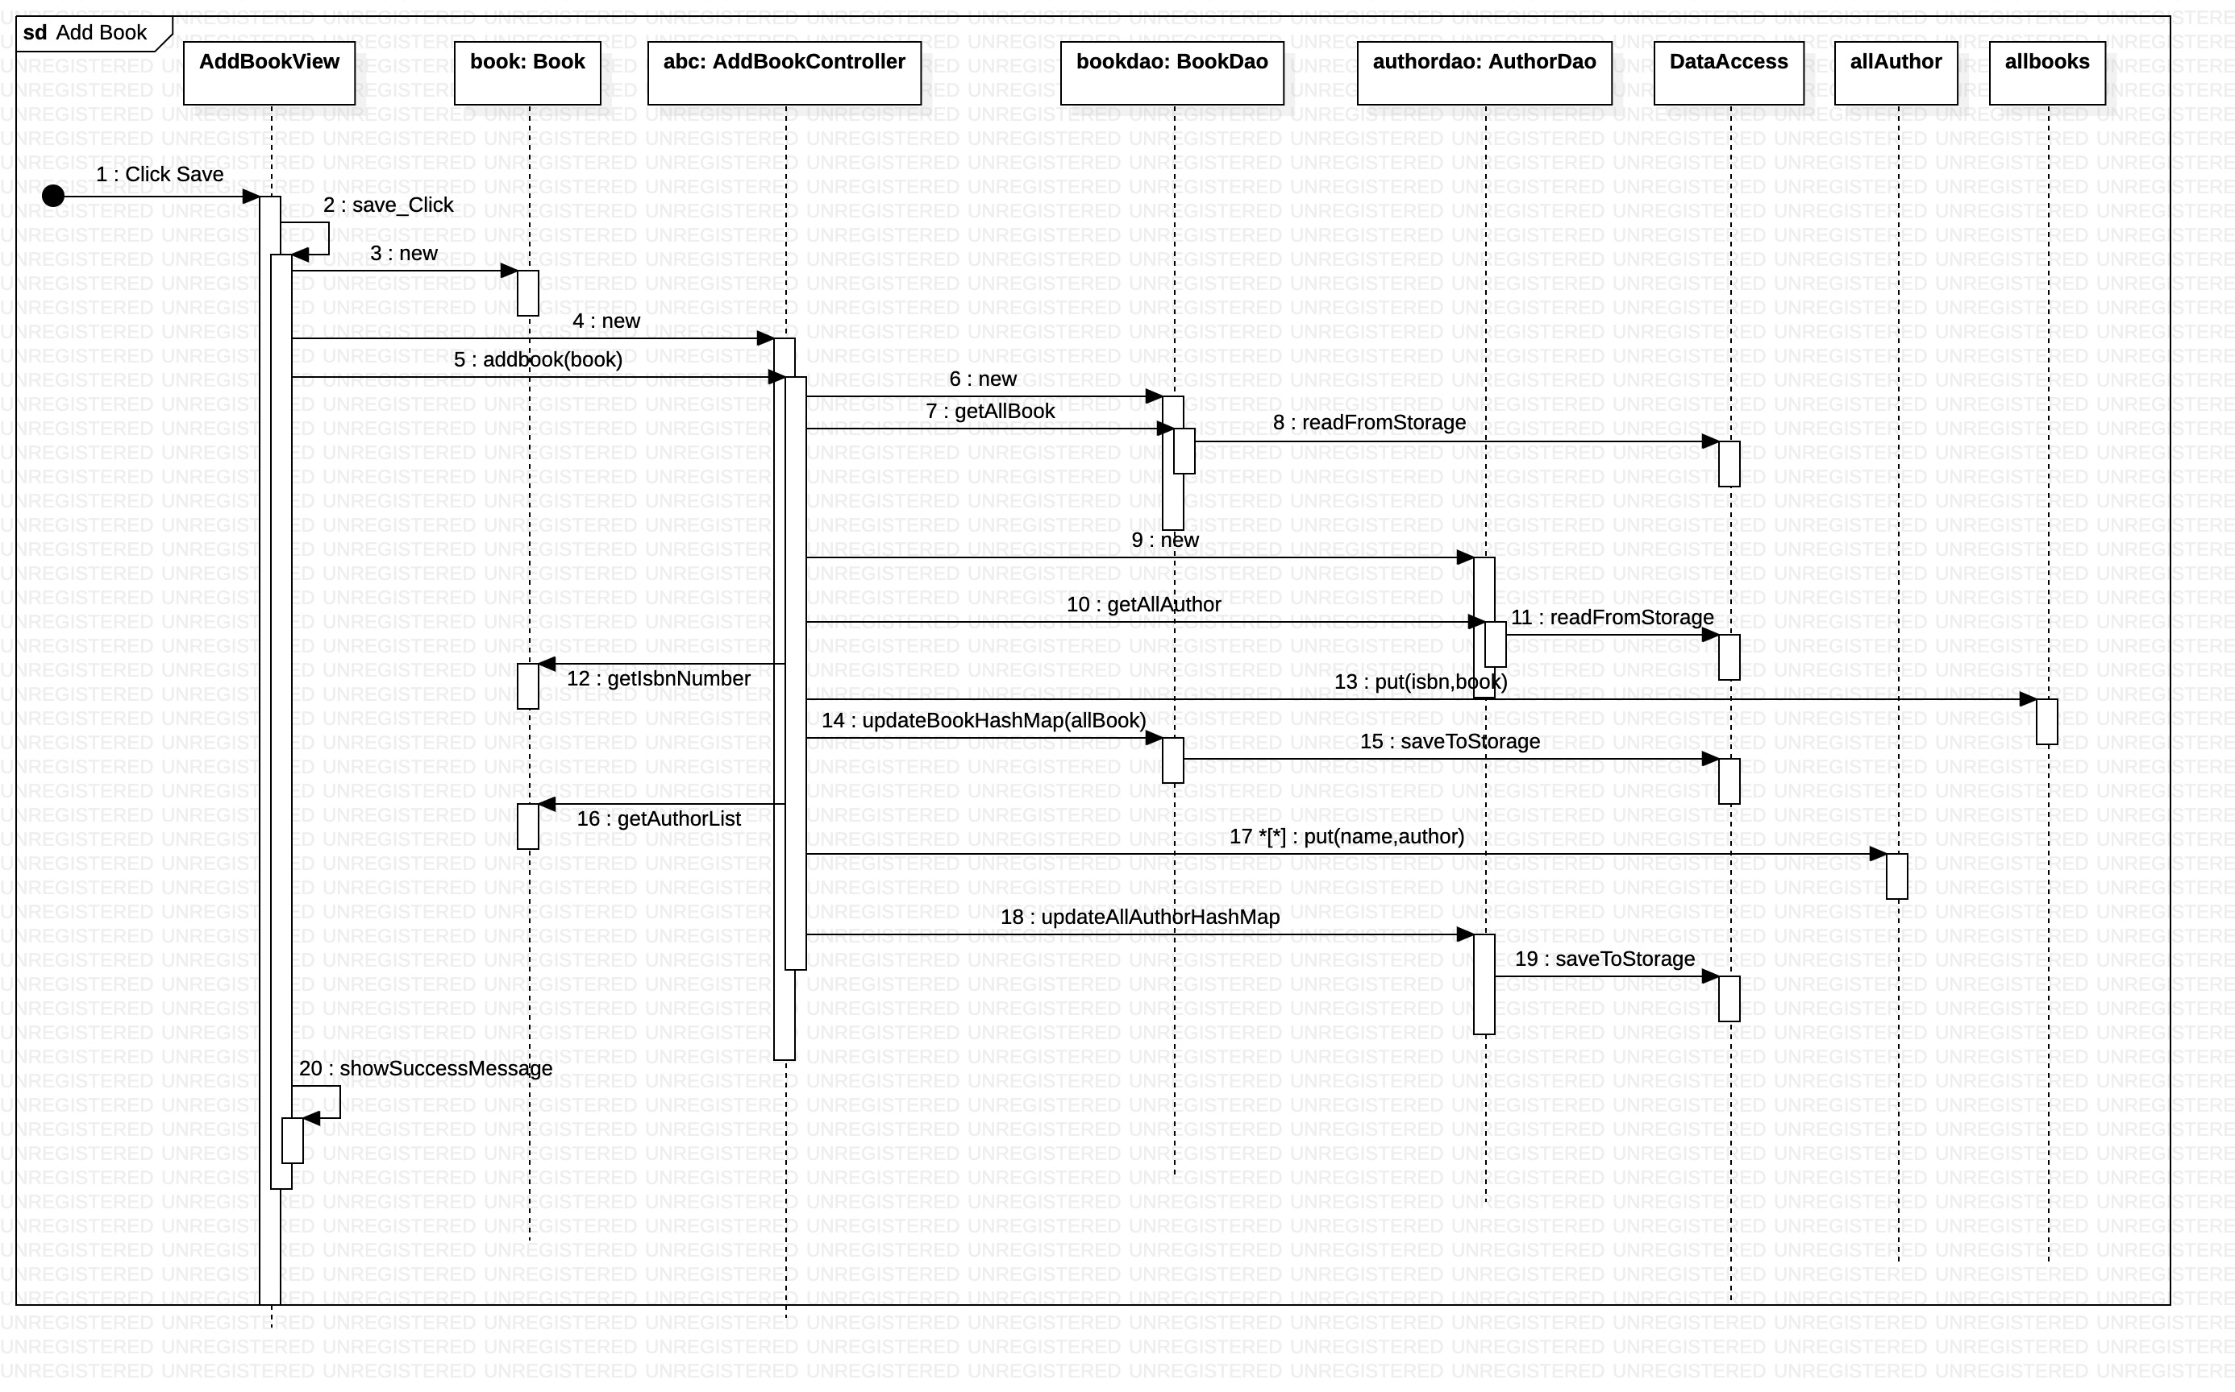

Slide 12
Checkout Sequence Diagram

Slide 13
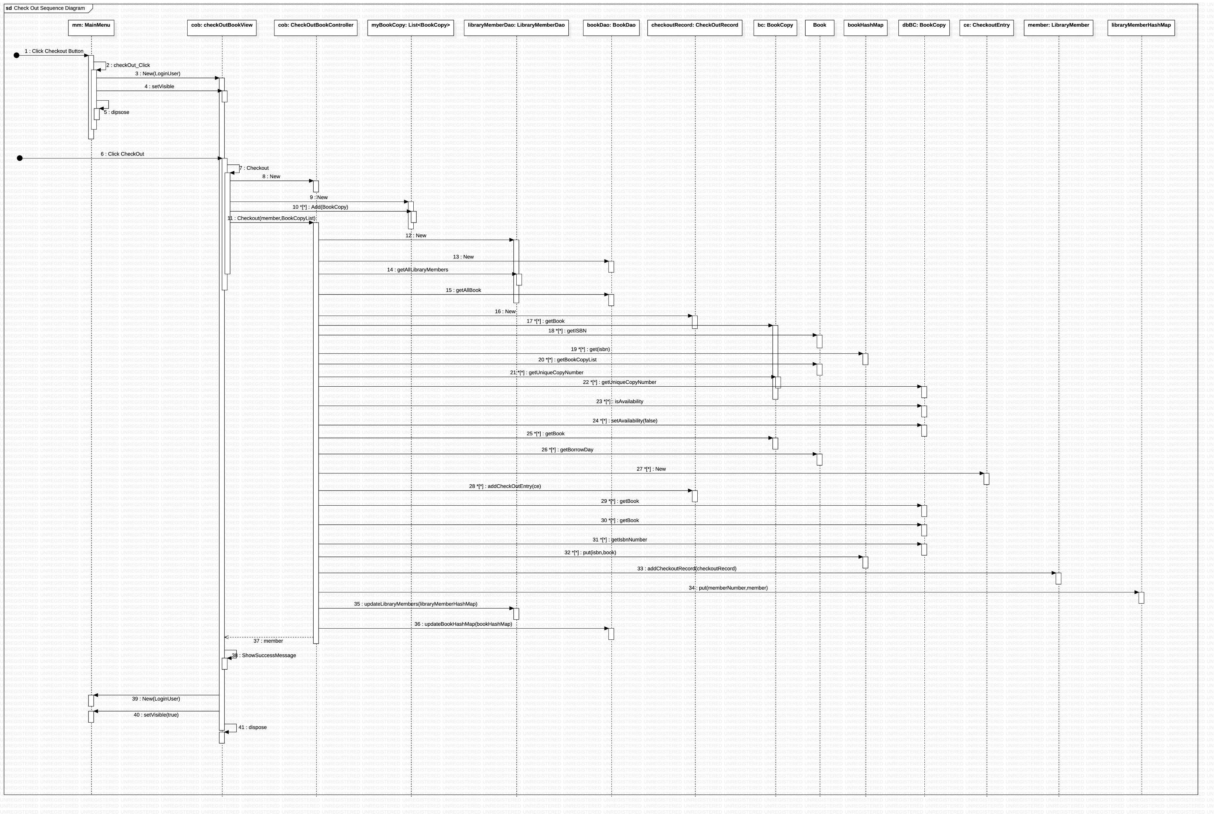

Slide 14
Add Member Sequence Diagram

Slide 15
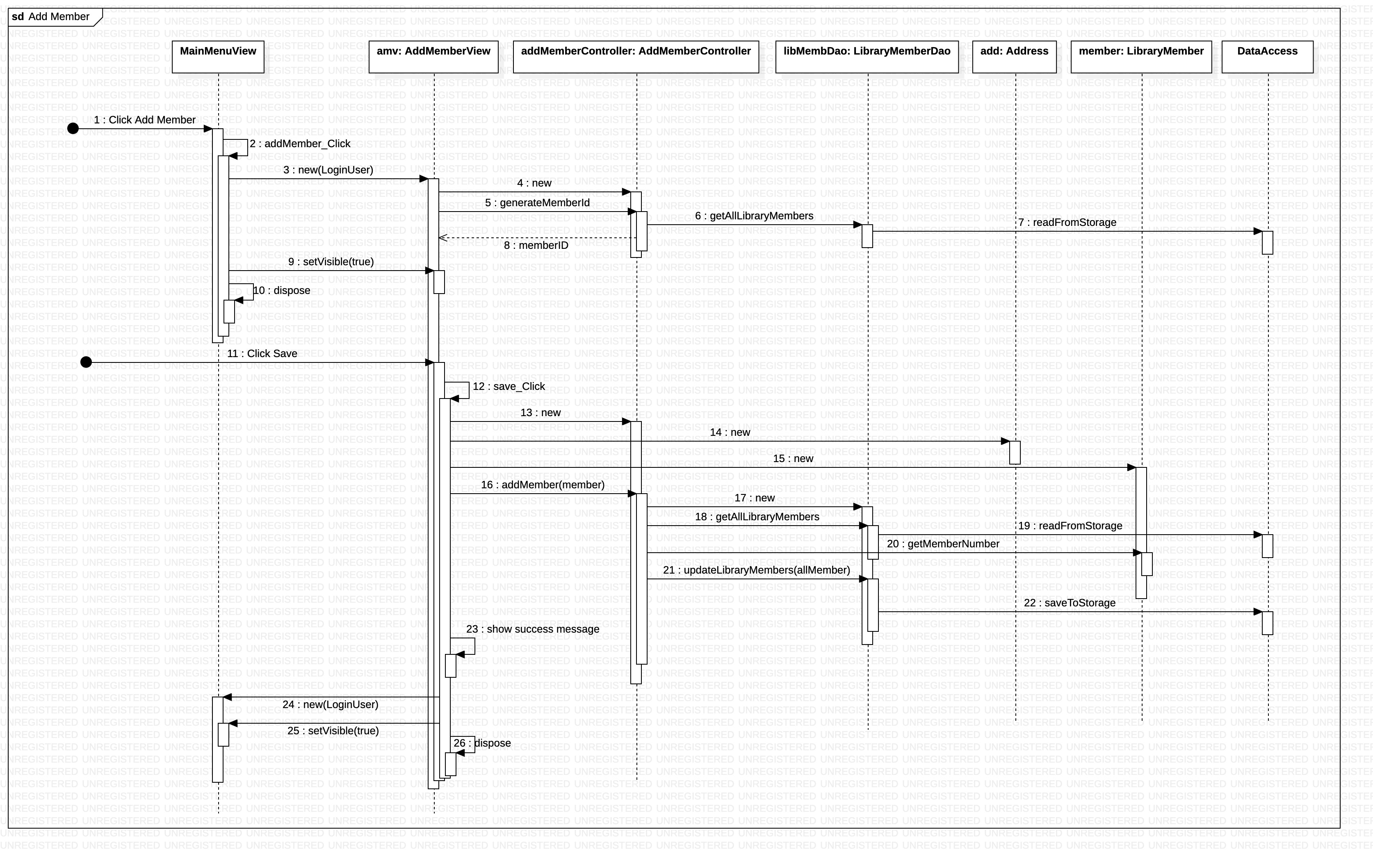

Slide 16
Extra Credit Use Cases

Slide 17
First Extra Credit Use Case
1- Given a library member id, print (to console) the checkout record of that library member The Librarian can search for a library member by ID, and then select an option to print the checkout record. When this is done, the checkout record appears in the console with aligned columns.

Slide 18
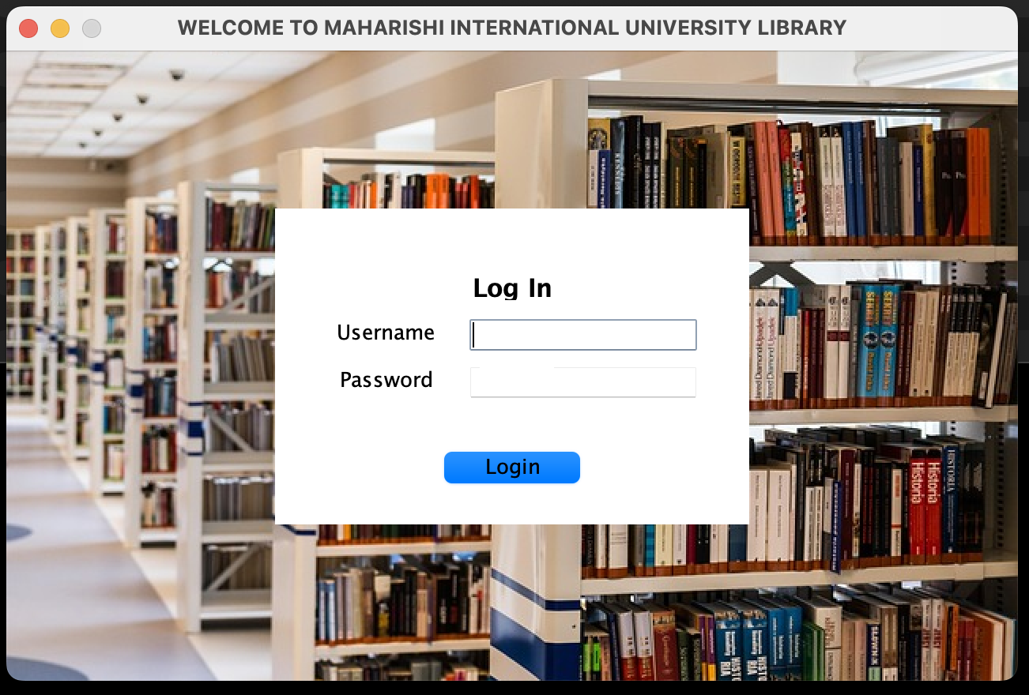
The user name is: lib1 and the password is lib1

Slide 19
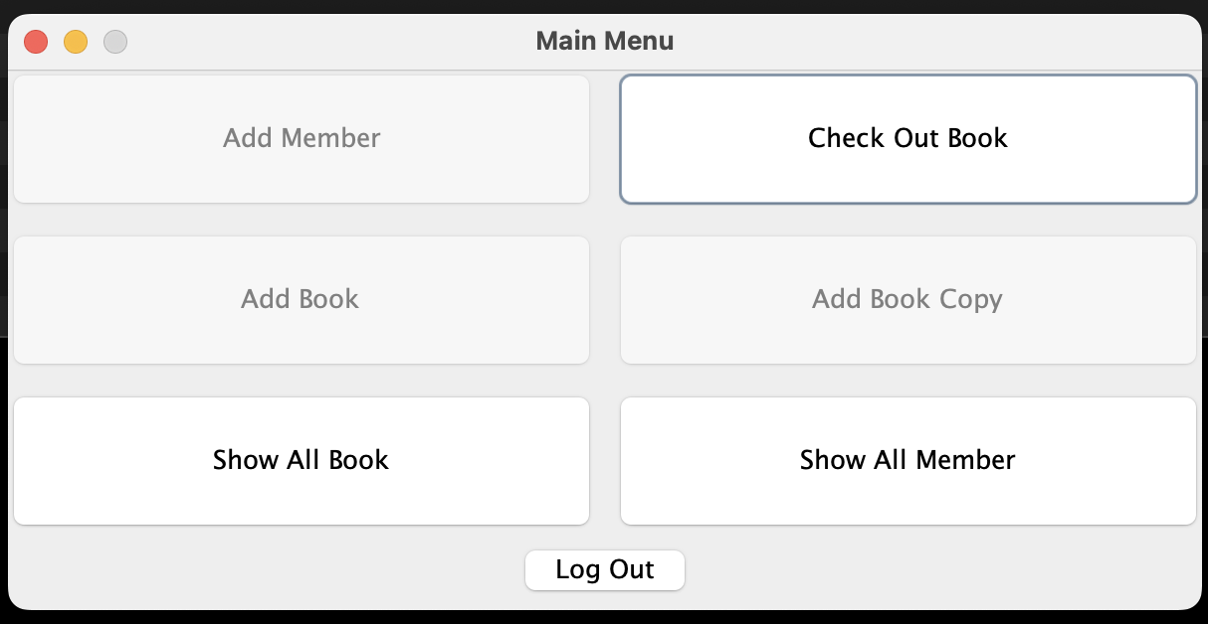
Click on Check Out Book button

Slide 20
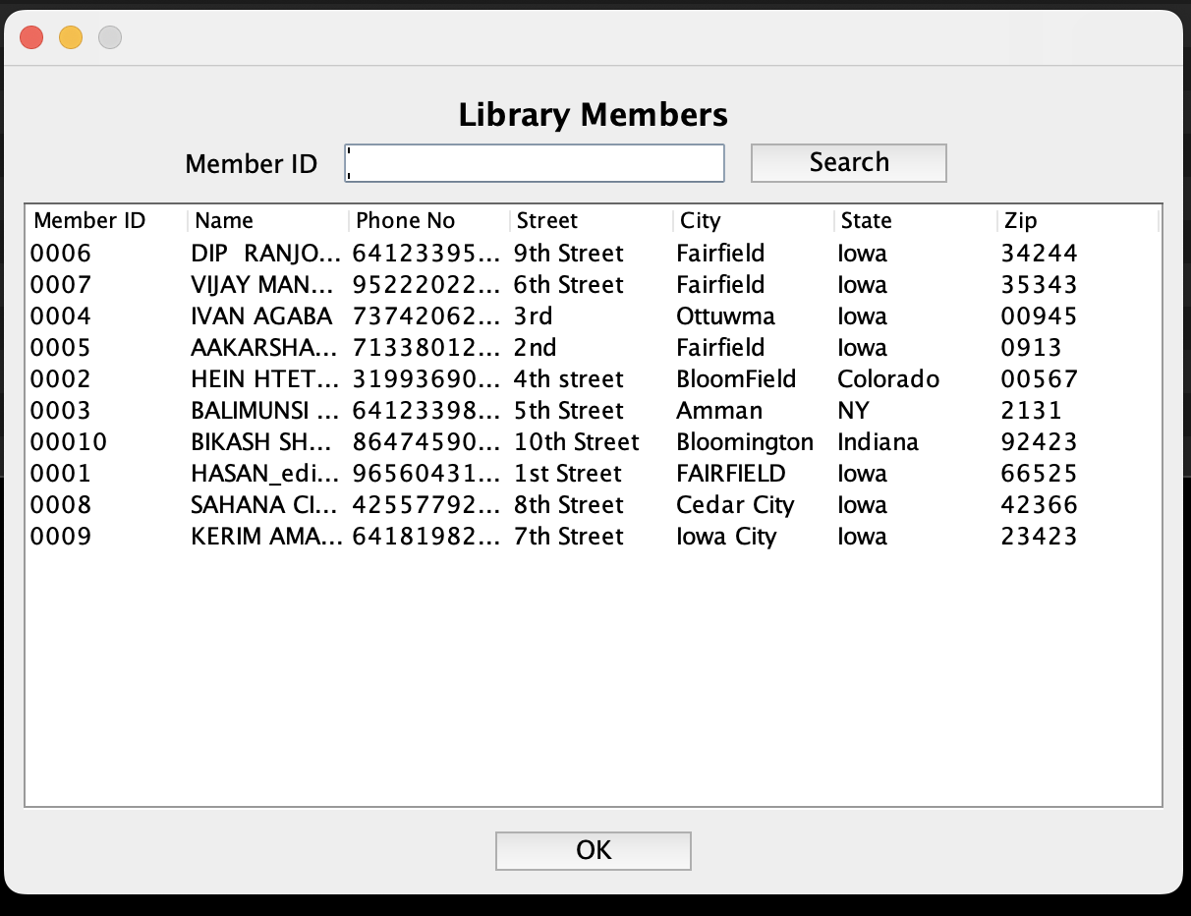
Search by member id

Slide 21
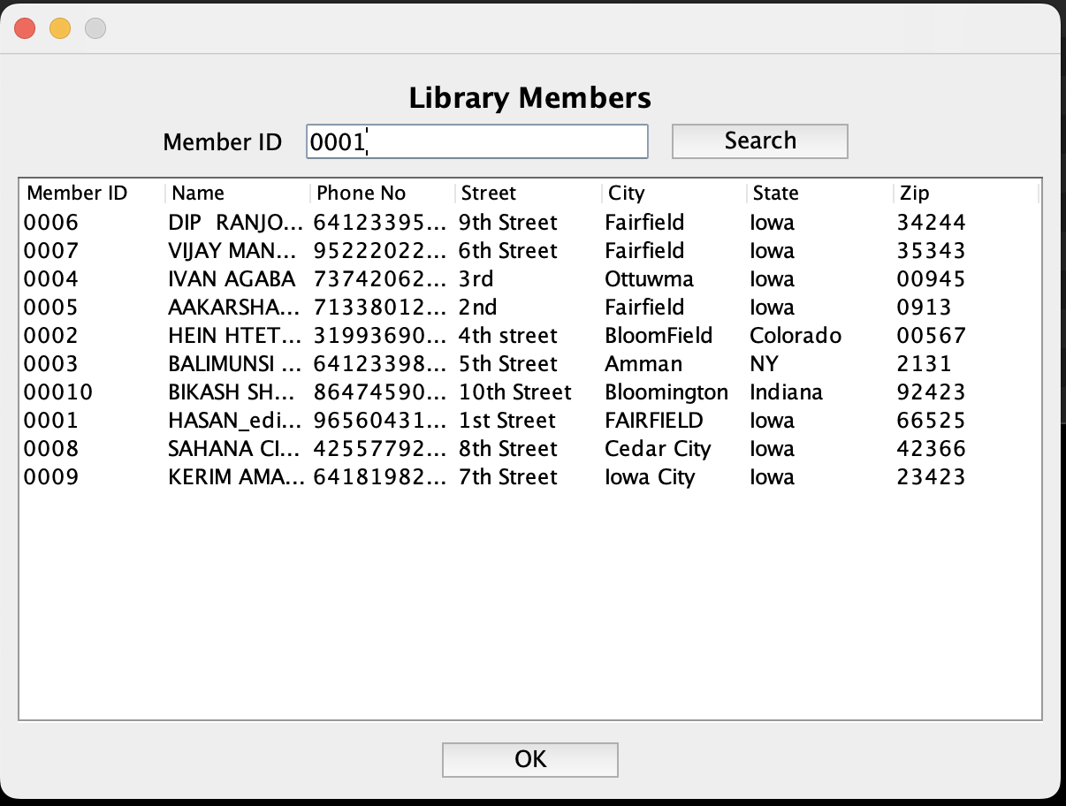
Click on search button

Slide 22
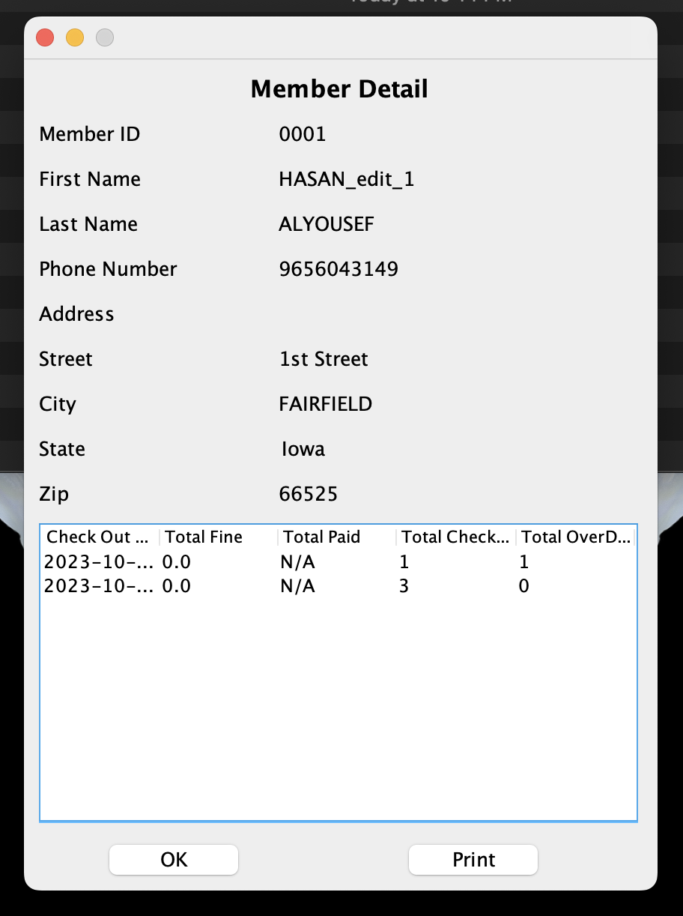
Click on Print button

Slide 23
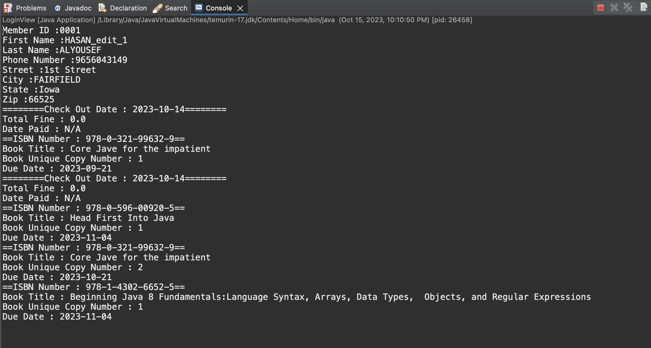
The data is printed on the console

Slide 24
Second Extra Credit Use Case
2. Determine whether a given copy of a publication is overdue, and which library member has it in his/her possession. “Overdue” means that the due date is before today and the status of the copy is “not available”. This should be implemented by providing a special screen for searching for books. The screen should make it possible to search for a book by ISBN, and the display should show, in a read-only JTable, the ISBN, book title, copy numbers of each copy, which library member (if any) has checked out a given copy, and when that copy is due back in the library

Slide 25
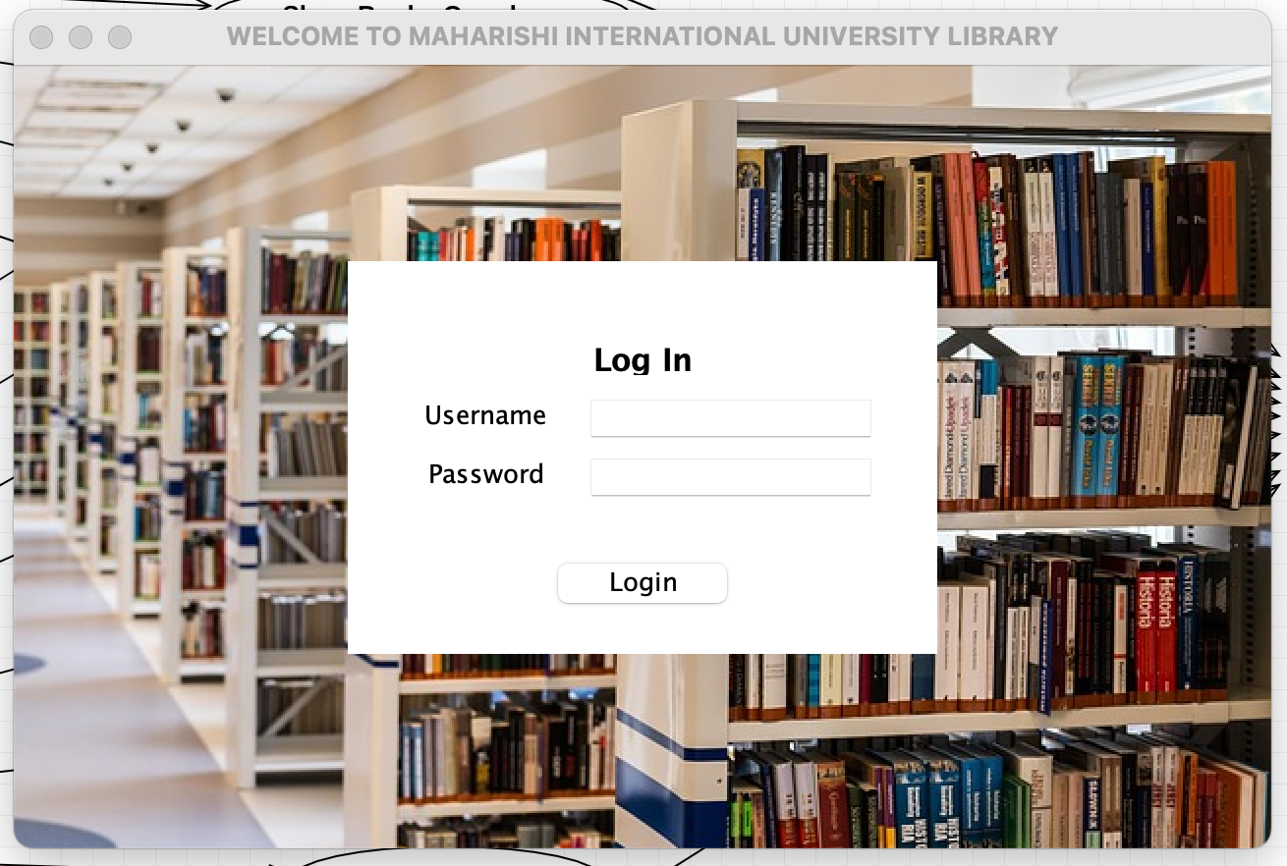
The user name is: lib1 and the password is lib1

Slide 26
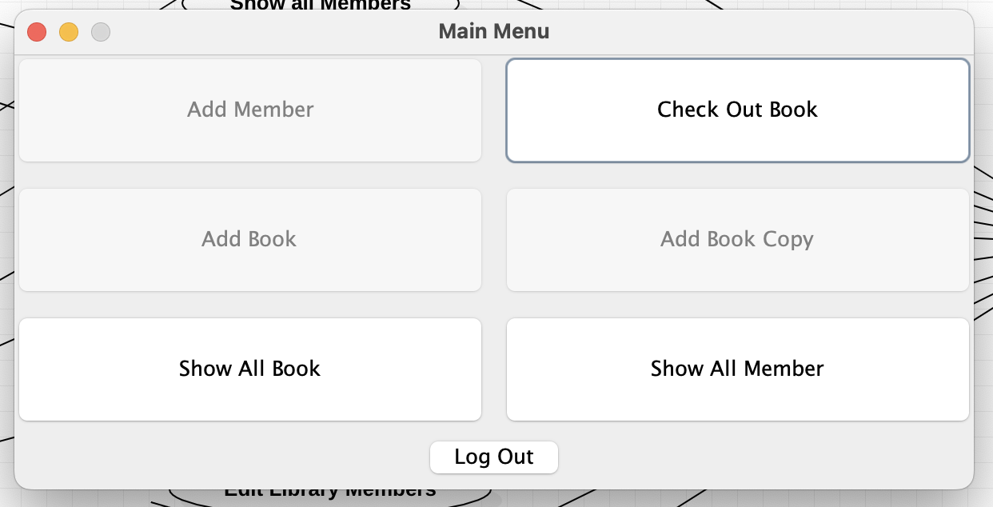
Click on Show All Book button

Slide 27
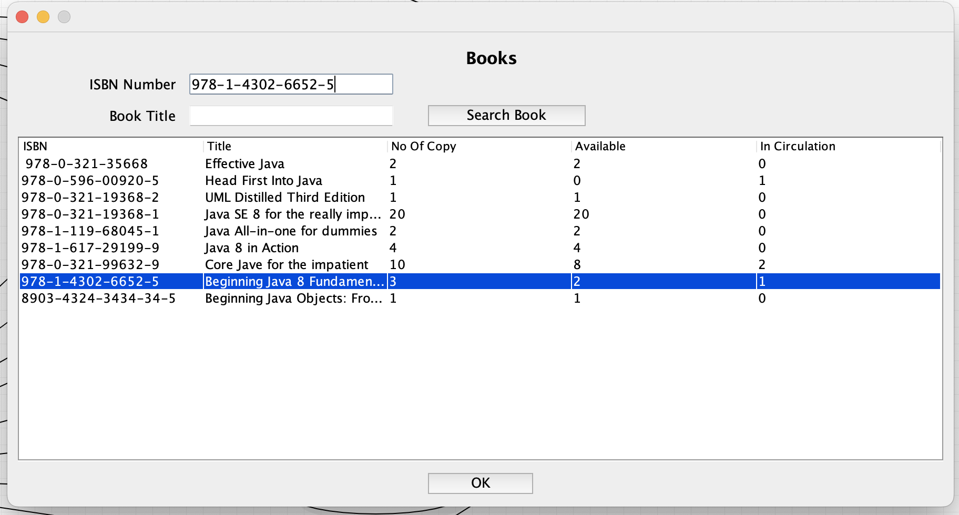
Search by book ISBN and double click on the book record

Slide 28
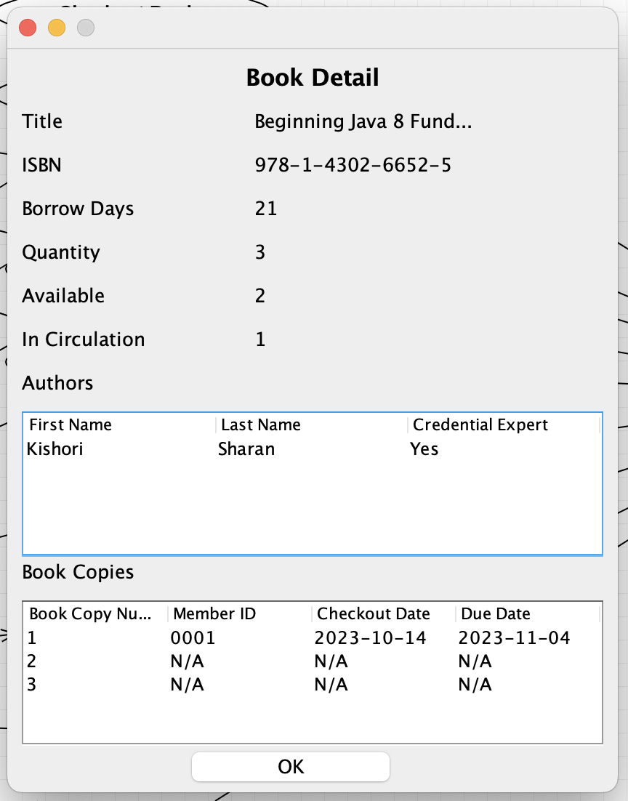
Click on the book copy record

Slide 29
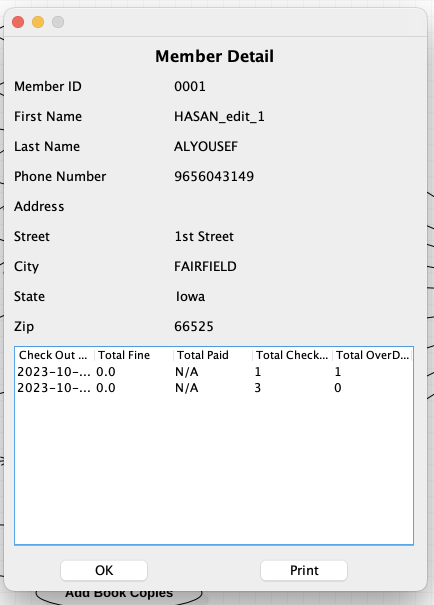
Click on print button

Slide 30
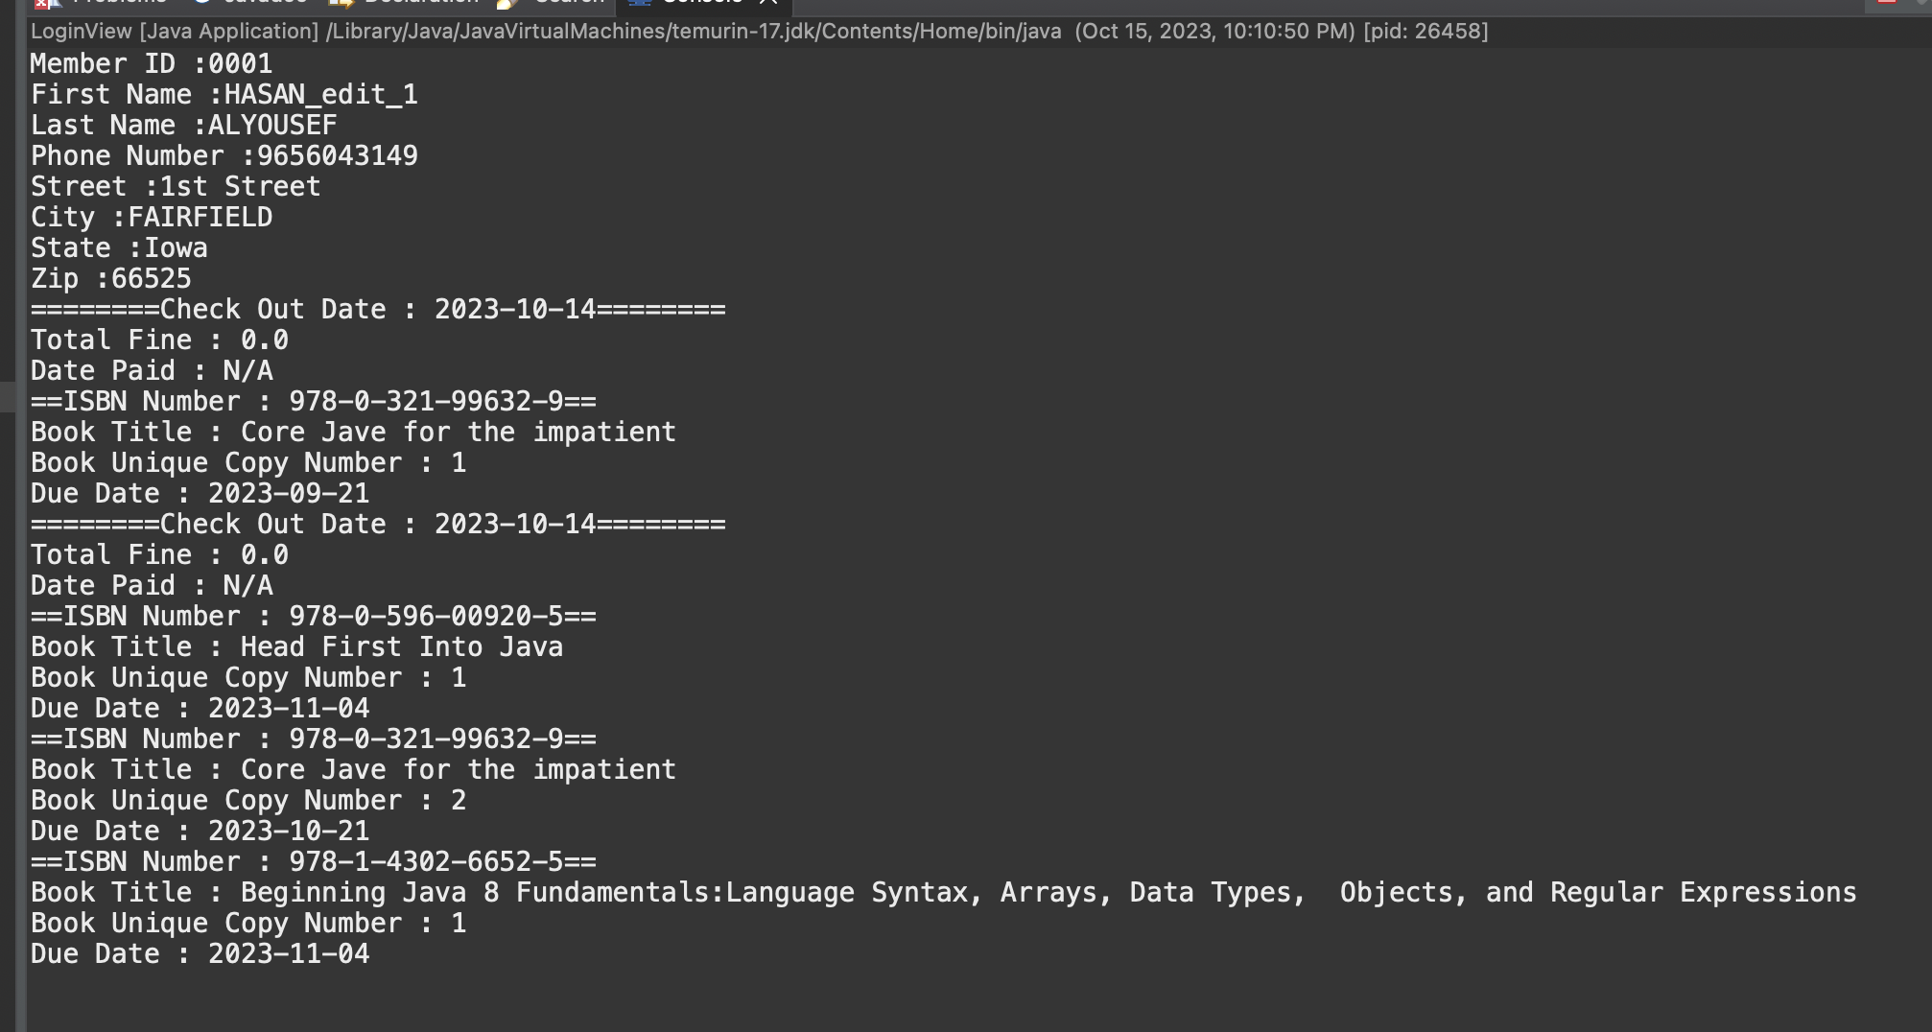
The data is printed on the console

Slide 31
Validation Rules of UI Windows

Slide 32
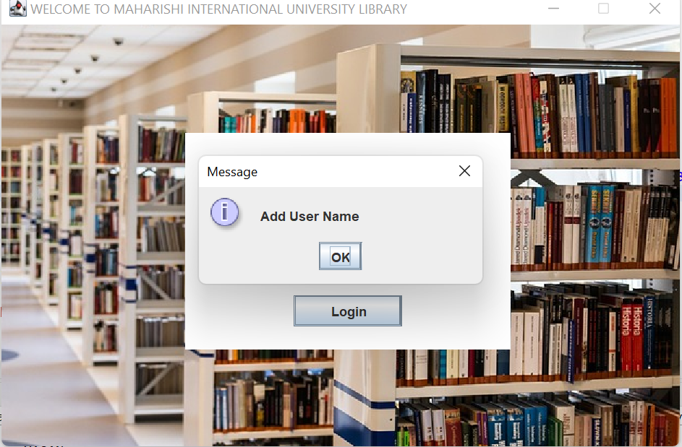

Slide 33
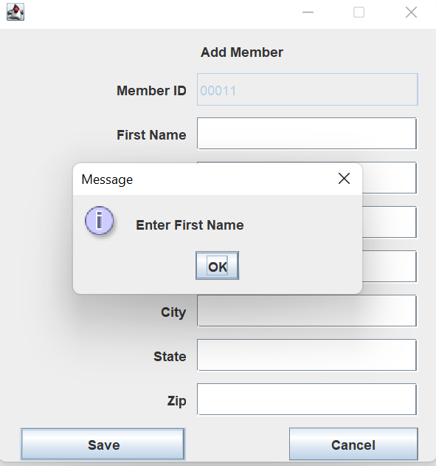

Slide 34
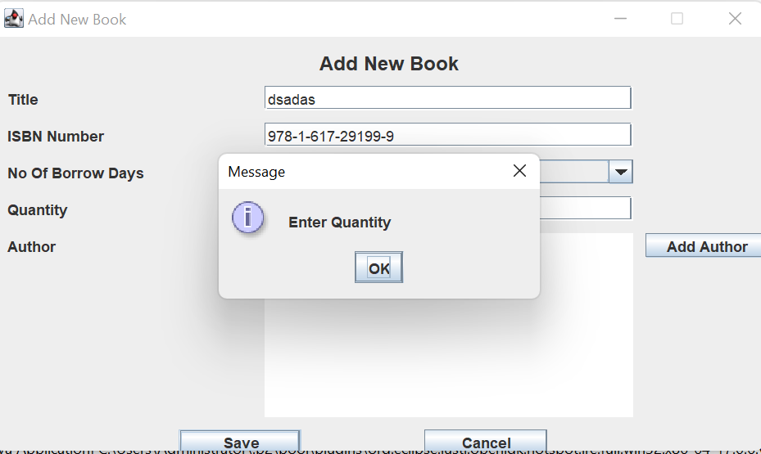

Slide 35
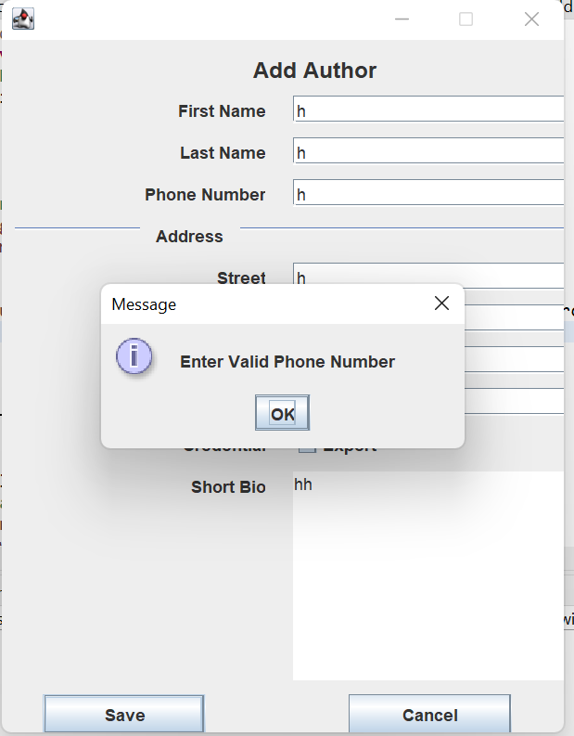

Slide 36
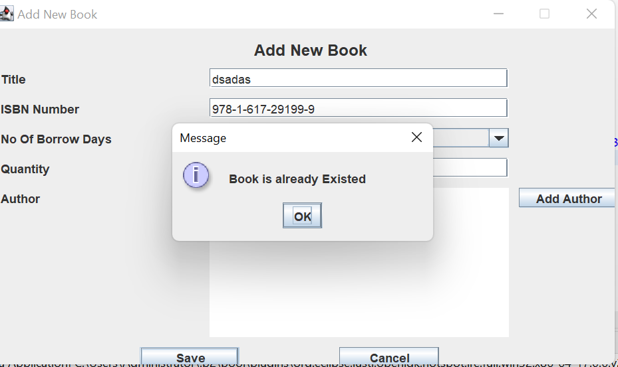

Slide 37
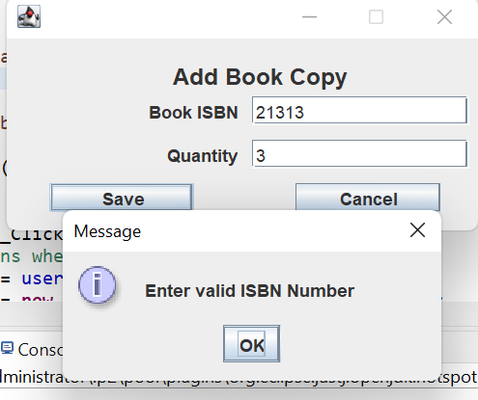

Slide 38
Conclusion with SCI Knowledge
The project has taught us the interaction of different classes to make one system run smoothly with different functionalities and use cases. This mirrors the principle of Science of Creative Intelligence: “unity in diversity”.
Adding a new member in the Library System is similar to one learning the practice of Transcendental Meditation. He can access limitless knowledge and creativity through daily meditation (exercising one’s privilege of using the library resources), and accessing the unified field of consciousness.
Checking out a book is the act of extending of pure intelligence to different users through TM. The ultimate provider of tools for creation of beautiful and functional content is pure intelligence. How we use this pure intelligence depends on individuals but the library system of all intelligence is the unified field of consciousness

Slide 39


